Slide 1


Machine Learning Dataset Preparation
Artificial Intelligence Training
Created by Andrew Ferlitsch Instructor
July, 2017

Slide 2
Dataset Preparation
Prior to using a dataset to train a model, the dataset
must be prepared.
Import the data
Clean the data (Data Wrangling)
Replace Missing Values
Categorical Value Conversion
Feature Scaling
Feature Engineering (not covered)

Slide 3
Importing the Dataset
Datasets are generally imported as a raw data files (e.g., US Census) or via an API service (e.g., NWS Weather Data SOAP API).
Datasets are generally in the form of CSV, JSON or XML
data format.
For the purpose of this tutorial, CSV is used in the
accompanying examples.

Slide 4
Importing the Dataset - Python
import pandas as pd # use pandas library for data frames
dataset = pd.read_csv( ‘data.csv’ ) # read CSV file into a data frame
CSV data converted
to data frame.
pathname to raw data file
Function to read a CSV file
Data Frame adds these indices
Example Data (CSV File): Generated Data Frame:
Age, Gender, Income, Spending 22,M,18000,6000 25,F,30000,8000
31,F,35000,12000
35,M,40000,18000
 | Age | Gender | Income | Spending
0 | 22 | M | 18000 | 6000
1 | 25 | F | 30000 | 8000
2 | 31 | F | 35000 | 12000
3 | 35 | M | 40000 | 18000

Slide 5
Cleaning the Data (Data Wrangling)
It is not uncommon for datasets to have some dirty
data entries (i.e., samples, rows in CSV file, …)
Common Problems
Bad Character Encodings (Funny Characters)
Misaligned Data (e.g., row has too few/many columns)
Data in wrong format.
Great Britain and the United States are two of the few places in the world that use a period to indicate the decimal place. Many other countries use a comma instead. Likewise, while the U.K. and U.S. use a comma to separate groups of thousands, many other countries use a period instead, and some countries separate thousands groups with a thin space.
https://docs.oracle.com/cd/E19455-01/806-0169/overview-9/index.html
Data Wrangling is an expertise/occupation all in its own.

Slide 6
Common Practices in Data Wrangling
Know the character encoding of the data file and intended character encoding of the data.
Convert the data encoding format of the file if necessary.
e.g., Notepad++ -> Encodings
Know the data format of the source and expected
data format.
Convert the data format using a batch preprocessing file.
e.g., 1 000 000 -> 1,000,000

Slide 7
Replace Missing Values
Not unusual for samples (rows) to contain missing (blank)
entries, or not a number (NaN).
Blank/NaN entries do not work for Machine Learning!
Need to replace the blank/NaN entry with something meaningful.
Delete the rows (generally not desirable)
Replace with a Single Value
Mean Average
Multivariate Imputation using Chained Equations (MICS)
https://msdn.microsoft.com/en-us/library/azure/dn906028.aspx

Slide 8
Missing Values – Mean Value
scikit-learn class for handling missing data
from sklearn.preprocessing import Imputer # scikit-learn module
# Create imputer object to replace NaN values with the mean value of the column imputer = Imputer( missing_values=‘NaN’,
strategy=‘mean’ )
# Fit the data to the imputer object
imputer = imputer.fit( dataset[ :, 2 ] )
# do the replacement and update the dataset
dataset[ :, 2 ] = imputer.transform( dataset[ :, 2 ] )
replace missing values in column 2 (index starts at 0)
original dataset
select all rows
needs to be the same columns in dataset

Slide 9
Categorical Variables
Independent Variables (Features)
Dependent Variables (Label)
Age | Gender | Income
25 | Male | 25000
26 | Female | 22000
30 | Male | 45000
24 | Female | 26000
Real Values
Value to Predict
Categorical Values

Slide 10
Dummy Variable Conversion
Known in Python as OneHotEncoder
For each categorical feature:
Scan the dataset and determine all the unique instances.
Create a new feature (i.e., dummy variable) in dataset, one per unique instance.
Remove the categorical feature from the dataset.
For each sample (row), set a 1 in the feature (dummy variable) that corresponds to that categorical value instance,
and:
Set a 0 in the remaining features (dummy variables) for that
categorical field.
6. Remove one dummy variable field.

Slide 11
Dummy Variable Trap
Need to Drop one Dummy Variable!
x1
x2
x3
Gender
Male
Female
Male
Female
Male | Female
1 | 0
0 | 1
1 | 0
0 | 1
Multicollinearity occurs when one variable predicts another.
i.e., x2 = ( 1 – x3)
As a result, a regression analysis cannot distinguish between the
contribution of x2 and x3.

Slide 12
Categorical Variable Conversion
scikit-learn class for categorical variable conversion
from sklearn.preprocessing import LabelEncoder # scikit-learn module
# Create an encoder object to numerically (enumeration) encode categorical variables labelEncoder = LabelEncoder()
# Fit the data to the Encoder object
dataset[ :, 1 ] = labelEncoder.fit_transform( dataset[ :, 1 ] )
# Create an encoder to convert numerical encodings to 1-encoded dummy variables
onehotencoder = OneHotEncoder( categorical_features = [ 1 ] )
# Replace the encoded categorical values with the 1-encoded dummy variables
dataset = onehotencoder.fit_transform( dataset )
encode the categorical values in column 1 (index starts at 0)
original dataset
select all rows
needs to be the same columns in dataset
Categorical variables to convert are in column 1
Dataset with converted categorical variables

Slide 13
Feature Scaling
If features do not have the same numerical scale
in values, will cause issues in training a mode.
If the scale of one independent variable (feature) is
greater than another independent variable, the model
will give more importance (skew) to the independent
variable with the larger range.
To eliminate this problem, one converts all the independent variables to use the same scale.
Normalization ( 0 to 1 )
Standardization ( -1 to 1 )

Slide 14
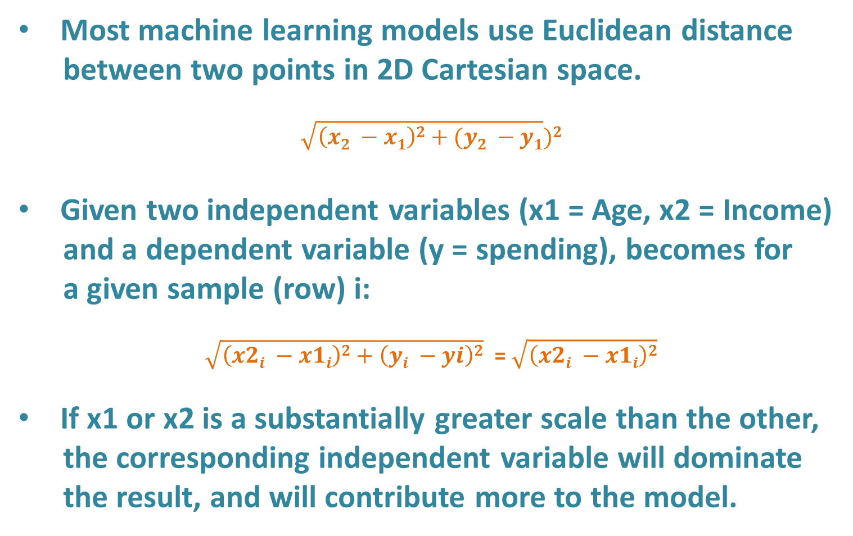
Scaling Issue - Euclidean Distance
Most machine learning models use Euclidean distance
between two points in 2D Cartesian space.
$$\sqrt{\left(x2 −x1\right)2+(y2 −y1})2$$
Given two independent variables (x1 = Age, x2 = Income)
and a dependent variable (y = spending), becomes for
a given sample (row) i:
$\sqrt{\left(x2i −x1i\right)2+\left(yi −yi\right)2}$ = $\sqrt{\left(x2i −x1i\right)2}$
If x1 or x2 is a substantially greater scale than the other,
the corresponding independent variable will dominate
the result, and will contribute more to the model.

Slide 15


Normalization or Standardization
Feature Scaling means scaling features to the same scale.
Normalization scales features between 0 and 1, retaining
their proportional range to each other.
Standardization scales features to have a mean (u) of 0
and standard deviation (a) of 1.
new value
original value
Normalization
X’ =
$$\frac{x −min⁡(x)}{\max\left(x\right)−min⁡(x)}$$
new value
original value
$$\frac{x −u}{a}$$
mean
Standardization
X’ =
standard deviation

Slide 16
Feature Scaling in Python using Sci-kit learn
scikit-learn class for Feature Scaling
from sklearn.preprocessing import StandardScalar # scikit-learn module
# Create a scaling object to scale the features.
scale = StandardScalar()
# Fit the data to the Scaling object and transform the data
dataset [:,-1] = scale.fit_transform( dataset[:,-1] )
feature scale all the variables except the last column (y or label)

Slide 17
Feature Scaling in Python with Panda Dataframe
import numpy as np # numpy module for arrays
import pandas as pd # pandas module for data frames
# Read a CSV file into a data frame
df = pd.read_csv(‘data.csv’)
# Use lamda expression to iteratively scale each column
df.apply(lambda x: (x - np.min(x)) / (np.max(x) - np.min(x)))
# Use lamda expression to iteratively scale each value in a specific column
df[‘income’].apply(lambda x: (x - np.min(x)) / (np.max(x) - np.min(x)))
x represents a column (vector)
x represents a value in a column (scalar)

